Slide 1

GEOSPATIAL ANALYSIS-PROPERTY RATE PREDICTION
Karan Thevar
Pratik Patre
Rahul Chandra

Slide 2



TEAM 3
Karan Thevar Pratik Patre Rahul Chandra

Slide 3
Introduction
Property rates depend on factors like the total area, type of property or how much is the development in the area, as well spatial components. Spatial components can be one of the most important factors in determining the price of a location. Some of these components include the fatality rate due to natural calamities, the crime rates or number of hospitals, police and other facilities like these in an area.
The purpose of this project is to use the spatial components to perform various analysis and predictions.

Slide 4
USECASes
To show a User 5 probable property listings as per his input values.
To predict the prices of these property listings after 10 years as per the historical data of the property.
To predict the property price after 10 years per geospatial data.
To find out the current property rate for State of Texas based on above all parameters.

Slide 5
DATASET
POLICE :http://www.50states.com/texas/police_departments.htm
POPULATION :https://www.dshs.texas.gov/chs/popdat/downloads.shtm
TRAGEDY : https://www1.ncdc.noaa.gov/pub/data/swdi/stormevents/csvfiles/
HOSPITAL : https://www.arcgis.com/home/webmap/viewer.html?useExisting=1&layers=b3813b2d3a054c378247bf32bcd8d203
PROPERTY
CRIME

Slide 6
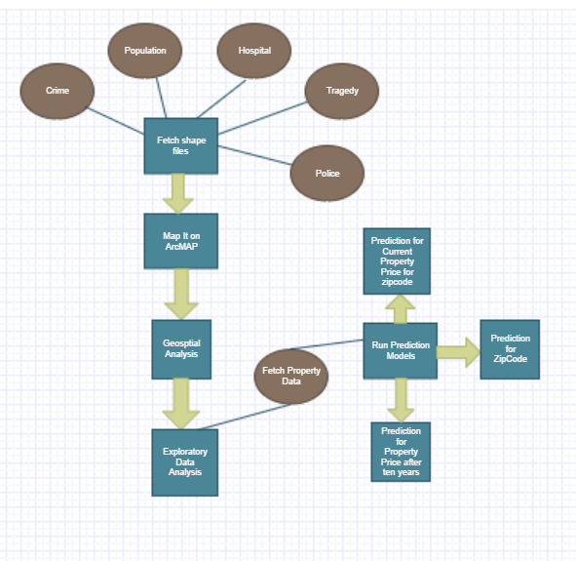
Flow Diagram

Slide 7
DEMO

Slide 8
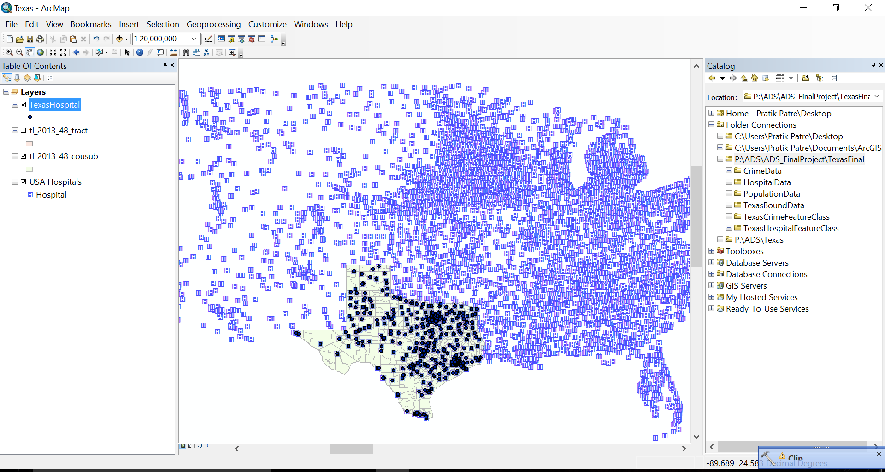

Slide 9
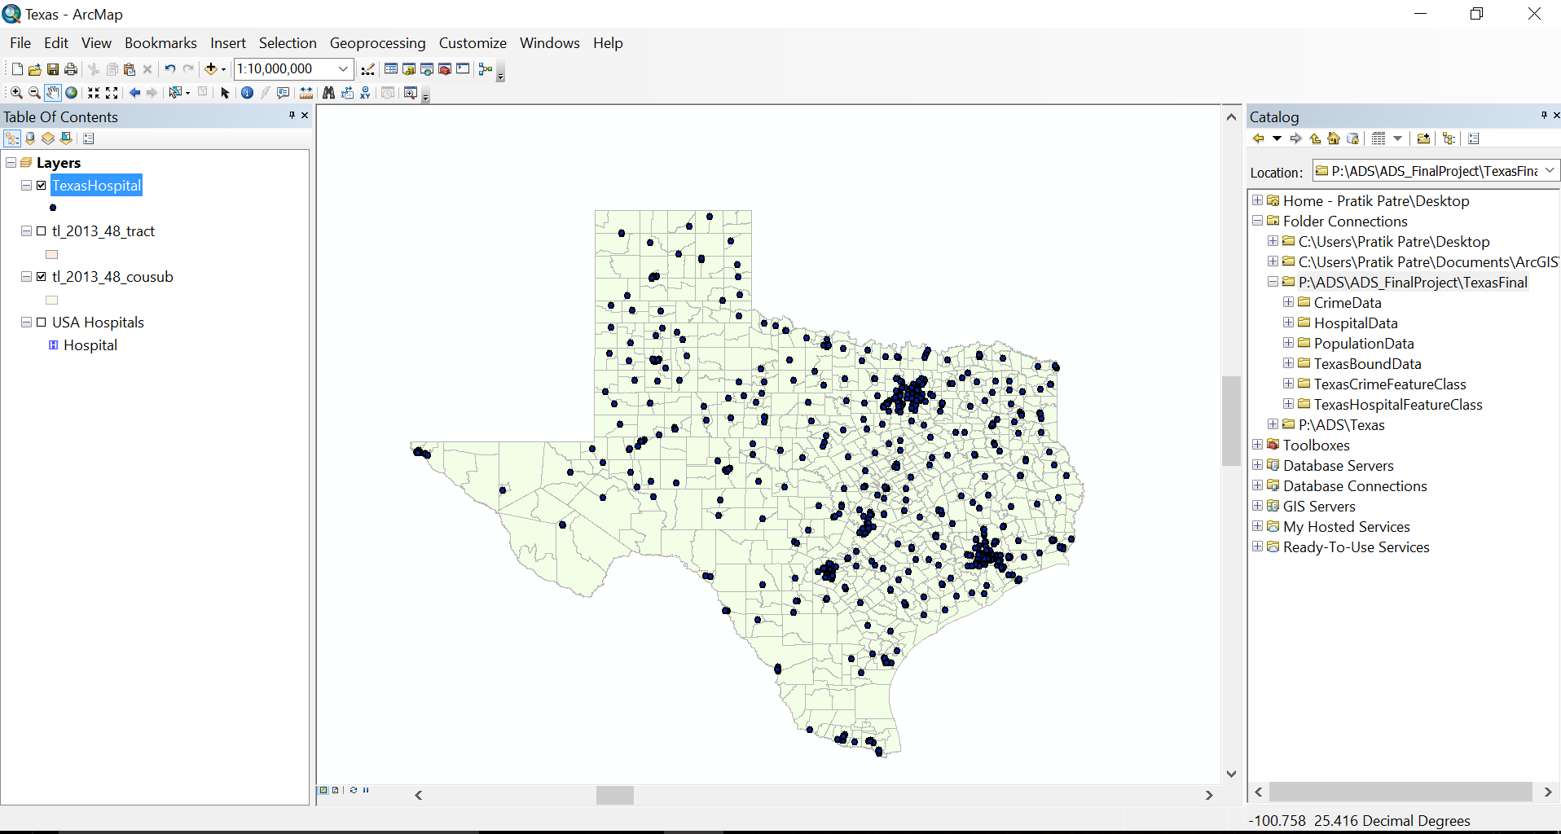
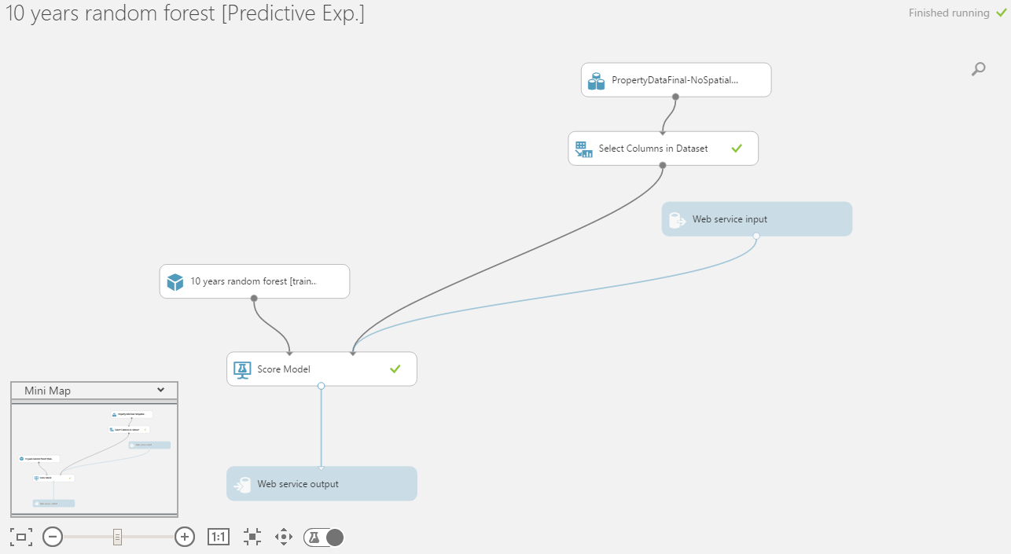

Slide 10
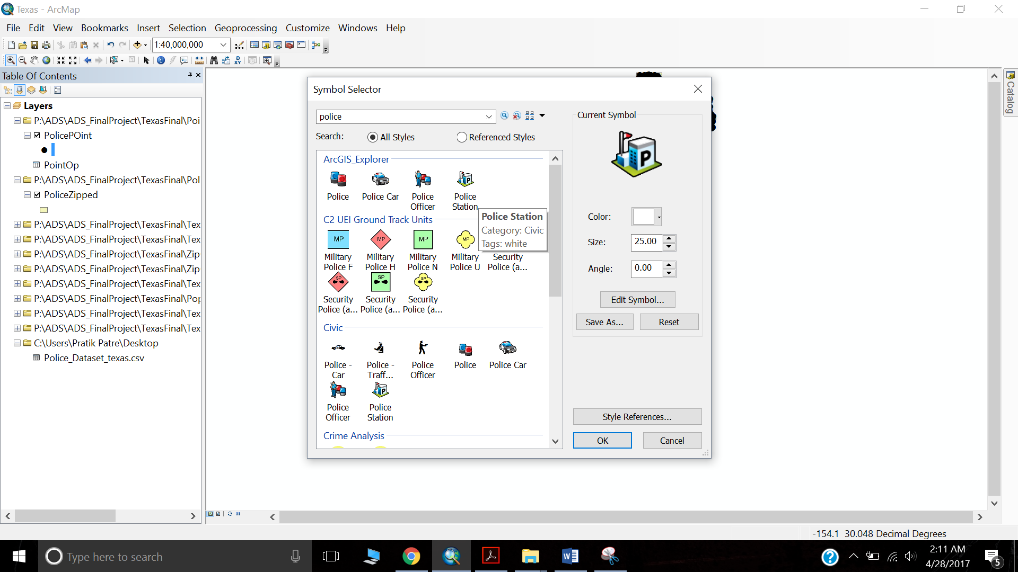

Slide 11
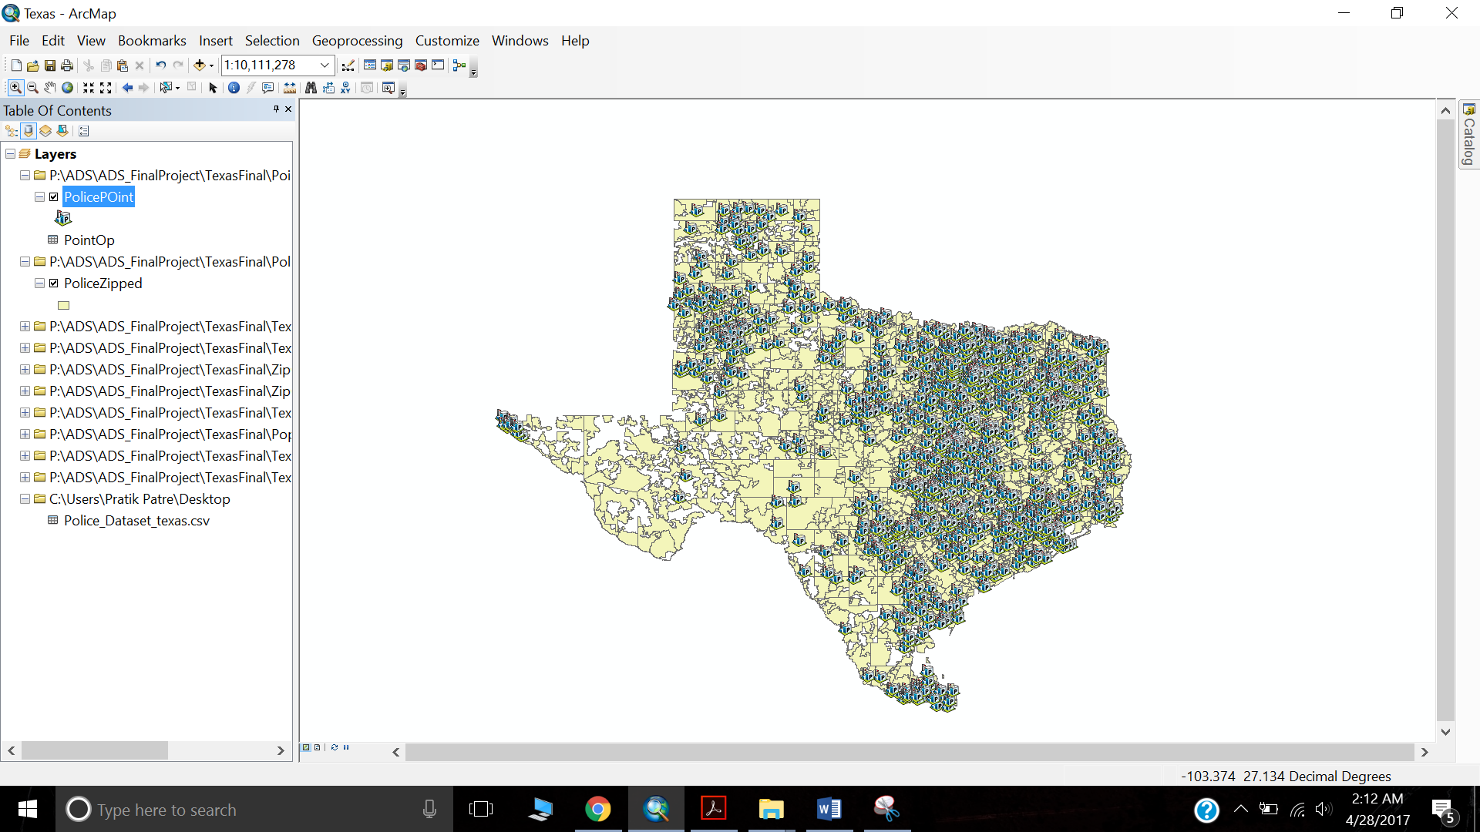

Slide 12
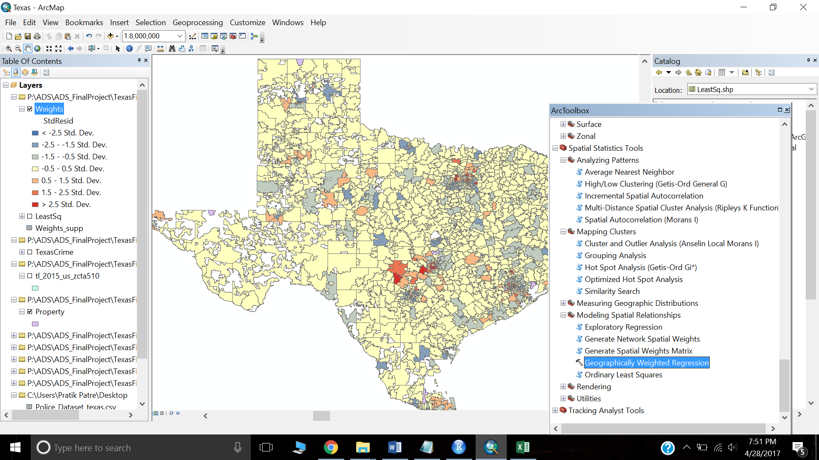

Slide 13
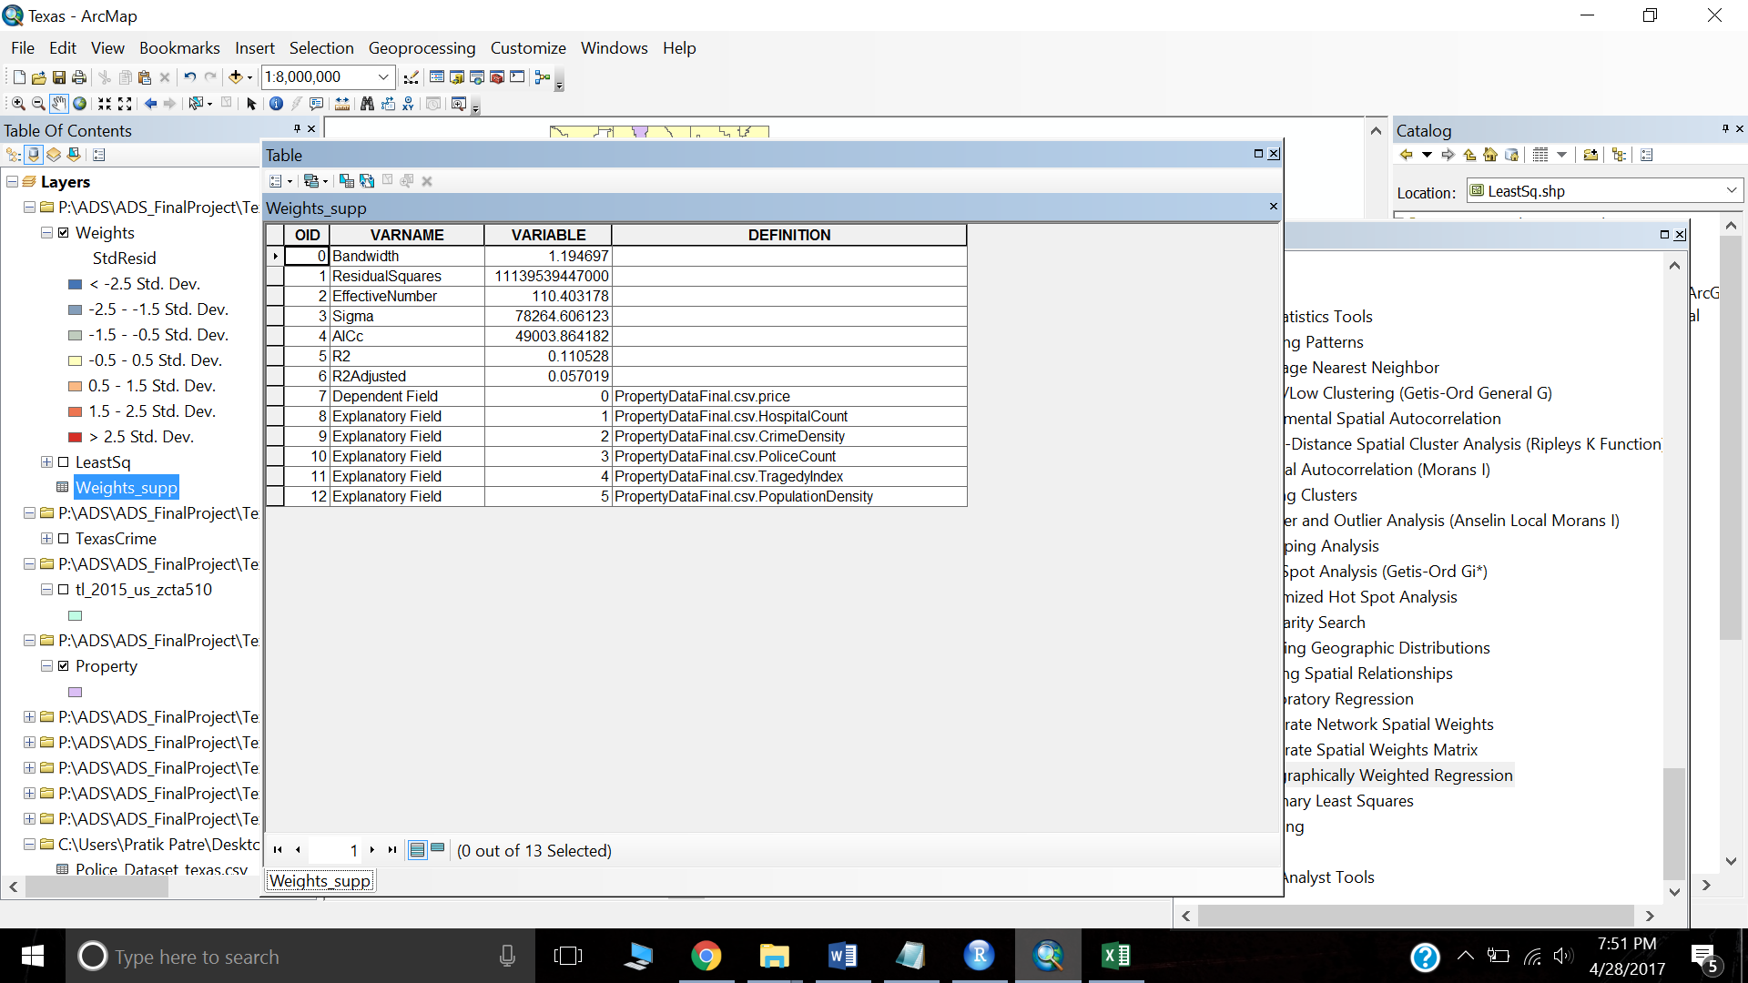

Slide 15
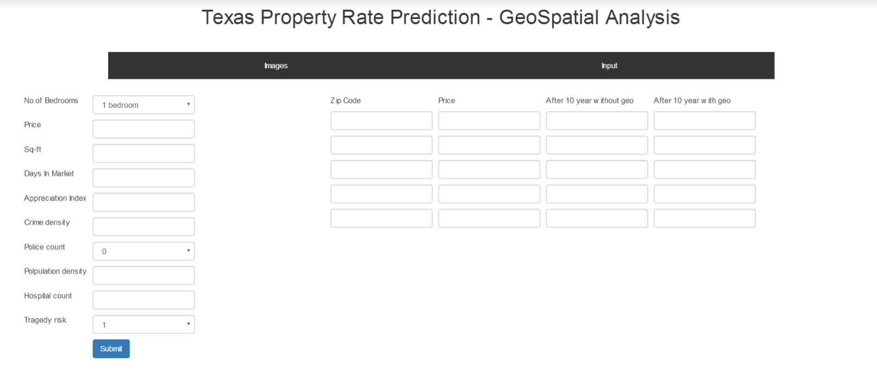
http://finalprojectads20170428113422.azurewebsites.net/

Slide 16
THANK YOU

